Slide 1






Customer Purchase Prediction using Machine Learning
An end-to-end AI-powered system that predicts which customers are most likely to buy — integrating a React frontend, FastAPI backend, and a Scikit-Learn model for real-time predictions.
Presenter: Hrydyansh Shukla
Python
FastAPI
Scikit-Learn
React & Vercel
Core language for data processing and model training.
Lightweight, high-performance REST API for serving predictions.
Model building and evaluation for binary classification.
Interactive UI deployed to Vercel for fast delivery.
GitHub
Source control and collaboration.
Notes:
1

Slide 2
Dataset & Features
A balanced mix of behavioural and demographic signals informs the prediction. Target: Purchase Prediction (binary).
Numerical Features
Categorical Features
Target
Age; Annual Income; Number of Purchases; Time Spent on Website; Customer Tenure; Last Purchase Days Ago; Session Count; Discounts Availed; Customer Satisfaction.
Gender; Product Category; Preferred Device; Region; Referral Source; Customer Segment; Loyalty Program.
Purchase Prediction — Binary classification: will-purchase / will-not-purchase.
Icons summarise each feature group to make the dataset structure easy to scan and remember.
Notes:
2

Slide 3

System Architecture
User
React Frontend
FastAPI API
Pydantic Validation
The frontend collects customer attributes, the FastAPI backend validates input with Pydantic, forwards features to the ML model, and returns a compact JSON prediction and probability for display.
Notes:
3

Slide 4
Machine Learning Pipeline
Data Preparation
Feature Engineering
Train & Evalualte
Serialize & Serve
Key note: the trained model is serialized using Joblib and served via FastAPI. Preprocessing objects (scalers/encoders) are bundled with the pipeline to ensure consistent production behaviour.
Notes:
4

Slide 5





Tech Stack
Modern, production-ready technologies across interface, API, ML, and deployment.
Frontend
Backend
Machine Learning
Deployment
React — dynamic forms and dashboard UI.
FastAPI — async endpoints, Pydantic validation.
Vercel for frontend hosting; backend served as a separate API (deploy option: cloud or container).
Scikit-Learn, Pandas, Joblib for training and serialization.
Version Control
Git & GitHub — collaboration, CI/CD readiness.
Notes:
5

Slide 6



Application Workflow & Demo
End-to-end prediction flow:
User enters customer details
Input validation (Pydantic)
API request to FastAPI
Model returns probability and binary prediction
UI displays prediction, confidence score, and recommended action
Input Form
Prediction Output
Confidence Score
Customer attributes captured via a clean, validated form.
Binary decision with probability and recommended marketing action.
Probability presented as a percentage for easy interpretation.
Live application: https://customer-purchase-prediction-puce.vercel.app
Notes:
6

Slide 7

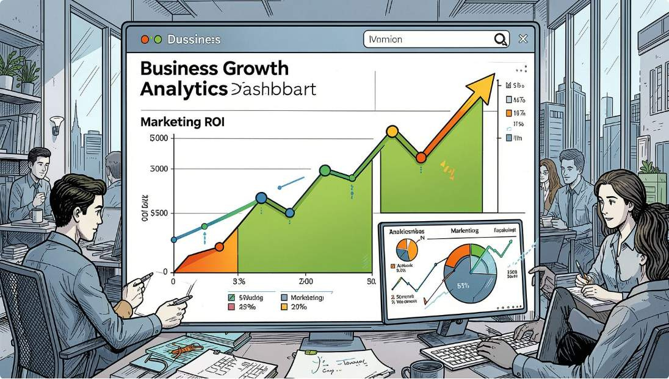
Key Features & Business Impact
1
FastAPI REST API
Low-latency endpoints for real-time scoring.
2
Pydantic Validation
Strong input contracts prevent bad requests and ensure feature consistency.
3
Pre-trained Scikit-Learn Model
Interpretable baseline and easy experimentation with advanced models.
4
Business benefits:
Interactive React Interface
Better customer targeting and segmentation
Personalised campaigns with higher conversion rates
Reduced advertising spend through focused outreach
Data-driven decisions and measurable ROI
User-friendly forms and visualization of prediction outcomes.
Notes:
7

Slide 8
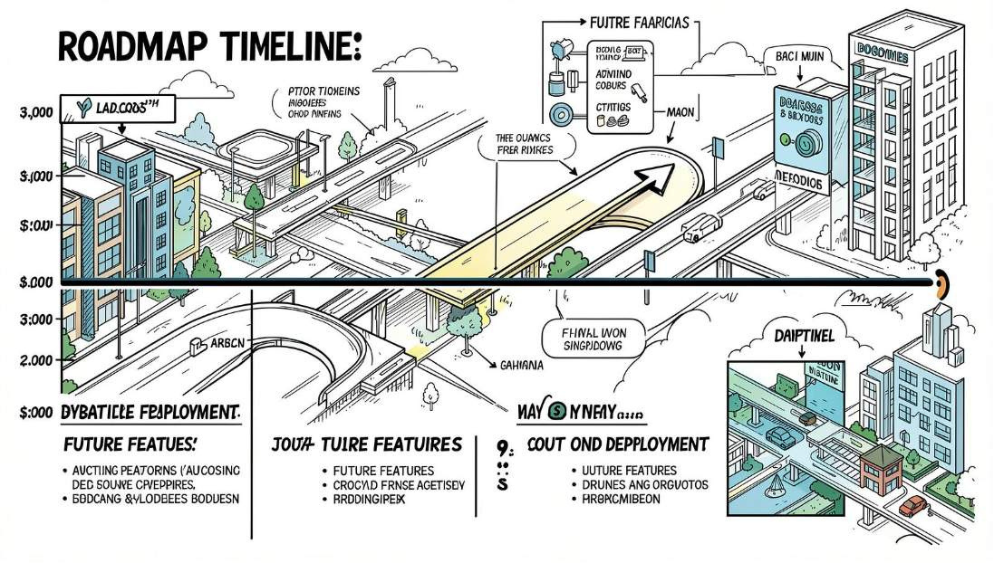
Challenges, Deployment & Future Scope
Future Scope
Experiment with XGBoost / LightGBM for improved accuracy
Extend to a Recommendation System for product suggestions
Integrate Explainable AI (SHAP/LIME) for model transparency
Containerize with Docker and add CI/CD for automated deployment
Migrate backend to AWS/GCP for scalable production hosting
Challenges
Robust data preprocessing and feature engineering
Handling high-cardinality categorical variables
Consistent model serialization and versioning
Seamless frontend–backend integration and error handling
Deployment
Code hosted on GitHub; frontend deployed to Vercel. Backend can be hosted on cloud functions, containers, or a managed API platform. CI/CD pipelines recommended for repeatable releases.
Notes:
8

Slide 9
Conclusion & Live Demo
This project is an end-to-end demonstration of how ML, API design, and modern frontend tooling combine to deliver actionable predictions for marketing. It showcases:
Practical ML model development and serialization (Joblib)
Robust API design with FastAPI and Pydantic
Interactive React UI deployed on Vercel
Repository: https://github.com/ihrysklps/Customer-Purchase-Prediction
Live app: https://customer-purchase-prediction-puce.vercel.app
Thank You
If you'd like a walkthrough, questions, or access to the code and deployment notes — I'm happy to demo live and share the implementation details.
Contact: hrysklps2305@gmail.com — available for technical discussions and further enhancements.
Notes:
9

